Slide 1
Content-based Visualization of Classical Music for Recommendation and Pattern Discovery
Kevin Yen
Advisor: Dr. Han-Wei Shen
Notes:
Hello everyone, my name is Kevin Yen, I’m a Computer Science master student, and today I’m presenting my master project, which is titled “Content-based Visualization of Classical Music for Recommendation and Pattern Discovery”. My advisor is professor Han-Wei Shen.

Slide 2
Motivation

Slide 3
Motivation
Text has been given much focus over the year, and Natural Language Processing (NLP) is well-developed.
How about music? How do we analyze music to recommend based on their content?

Slide 4
Recommendation systems
Metadata-based
Information around the product
Content-based
Information from the content

Slide 5
I like Harry Potter…
Staff A
“I don’t really read fantasy novels, but I’ll take you to the shelve of fantasy books.”
Staff B
“OH! I’ve read many similar books, let me grab you the one I know you would like!”
Which one would be more accurate?

Slide 6
Example: Paper recommendation
Metadata information
Authors
Year
Conference
Track
Content information
Abstract
Keywords

Slide 7
Example: Music recommendation
Metadata information
Artists
Album
Year
Content information
Lyrics
Music Information Retrieval (MIR)
User information

Slide 8
User Information
Collaborative filtering
Person 1: “I like tracks A, B, C, and D.”
Person 2: “I like tracks B, C, D, and E.”
Person 1: “You should check out track A!”
Person 2: “Sure, and you should try track E!”
Spotify & Netflix

Slide 9

When recommendations done right

Slide 10
Music Information Retrieval (MIR)
What are being retrieved?
Pitch
Key detection
Tempo estimation
Beat
Song structure

Slide 11
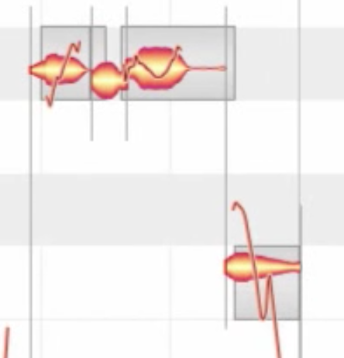
Music Information Retrieval (MIR)
What it’s been used for
Post-processing for music production
Vocal pitch tuning
Drum beat synchronizing
Music recommendation
Loudness
Tempo
Vocal gender

Slide 12
What’s different about this project
Music Information Retrieval (MIR) uses audio file
This project uses Midi and MusicXML files

Slide 13
Music theory

Slide 14
Music theory
A Generative Theory of Tonal Music (GTTM)
Based on pitch and duration of music notes, how can music be described with smaller phrases.
Result is a binary tree that represents the original music.

Slide 15
A Generative Theory of Tonal Music (GTTM)
Three steps:
Group analysis
When playing a flute, looking for when to breathe
Metrical analysis
When listening to music, looking for when to clap
Time-span tree analysis
How to abstractly describe a music

Slide 16
GTTM step 1 – group analysis
Group analysis rules:
GPR2a | Offset-to-onset duration
GPR2b | Onset-to-onset duration
GPR3a | Pitch change
GPR3b | Velocity change
GPR3c | Articulation change
… | …

Slide 17
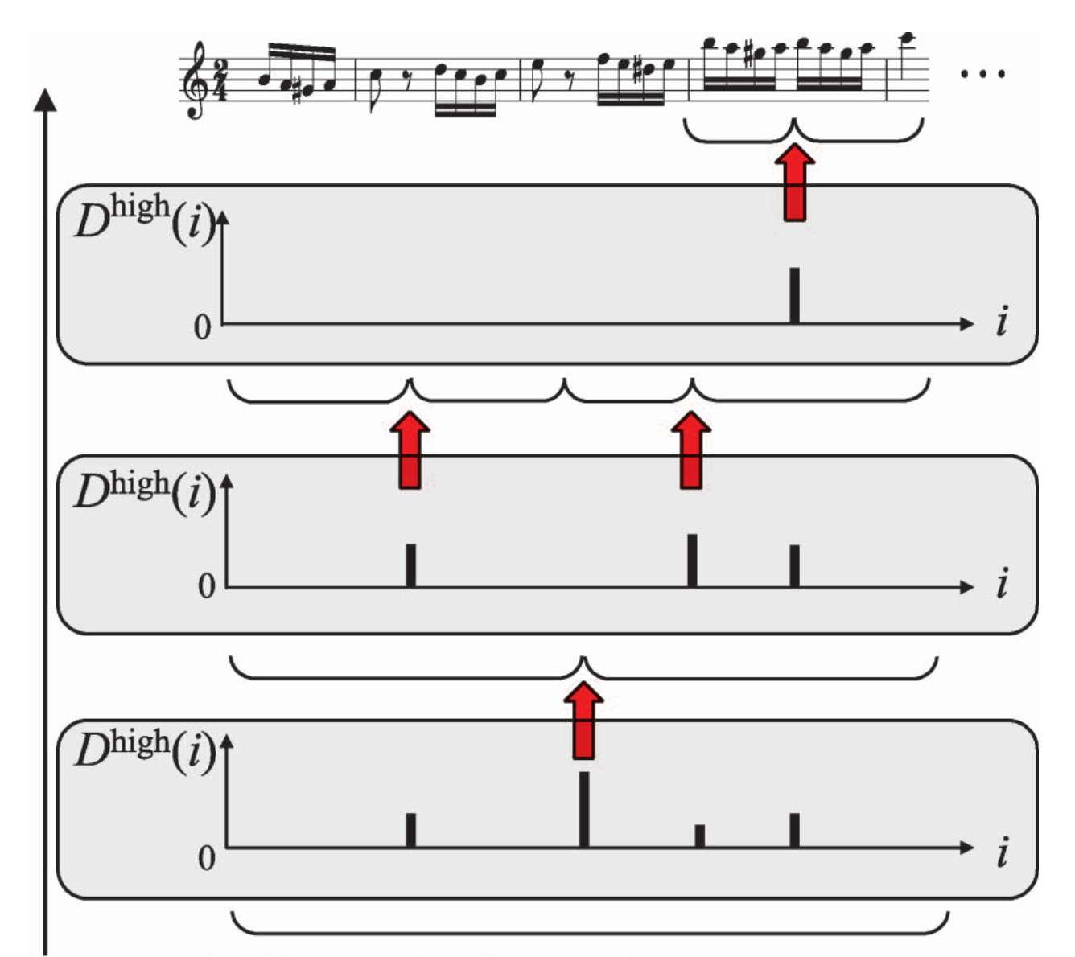
GTTM step 1 – group analysis

Slide 18
GTTP step 2 – metrical analysis
Metrical analysis rules
MPR2 | Earlier the better
MPR3 | Prefer notes rather than rests
MPR4 | Pitch change
MPR5a | Prefer long notes
MPR5b | Prefer notes with long articulation
… | …

Slide 19
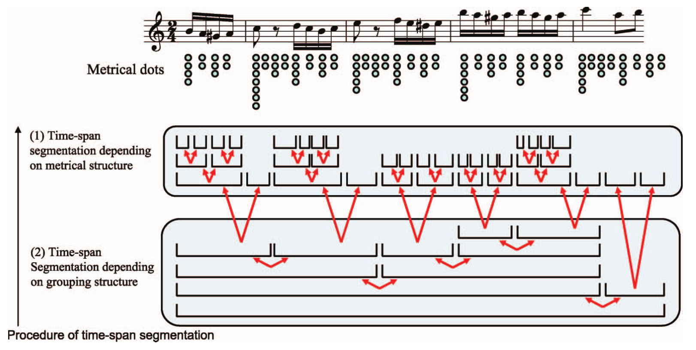
GTTP step 2 – metrical analysis

Slide 20
GTTM step 3 – time-span tree
Time-span reduction parameters
Numbers of dots
Note Durations
Pitch differences

Slide 21
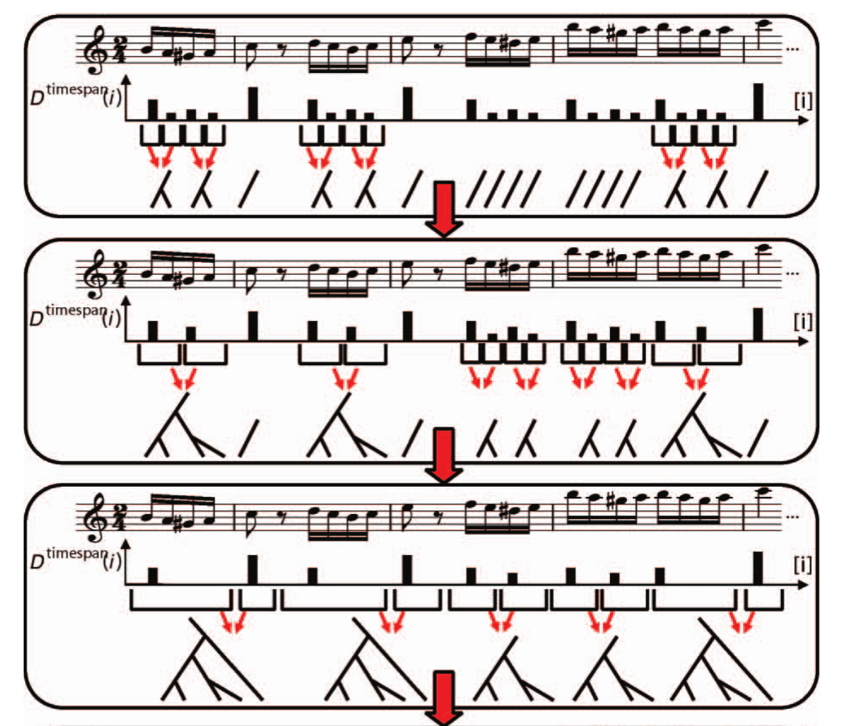
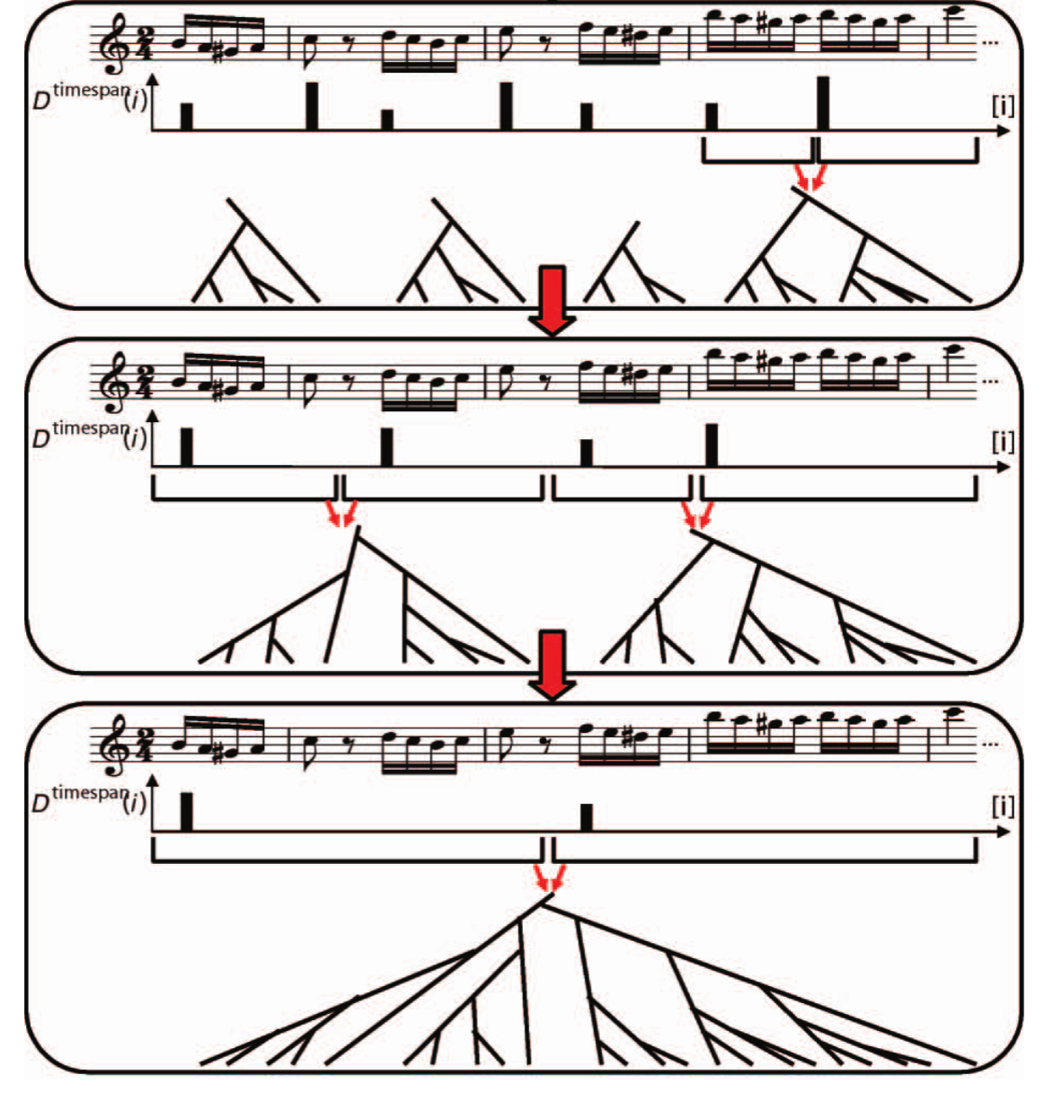
GTTP step 3 – time-span tree

Slide 22
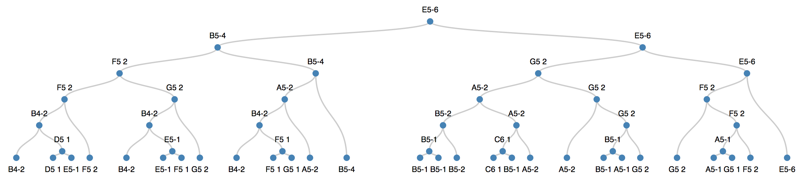
Time-span tree
Node points to one of the children as head node.

Slide 23
Tree comparison

Slide 24
Tree structure comparison
Tree editing distance – Zhang and Shasha
Insert
Delete
Substitute

Slide 25
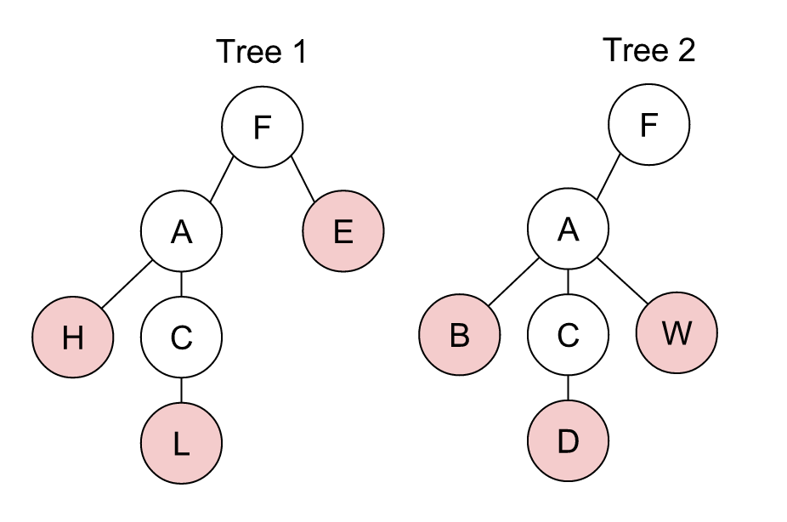
Tree structure comparison
Tree 1 and Tree 2’s difference
Substituting H with B
Substituting L with D
Inserting W to A
Deleting E from F

Slide 26
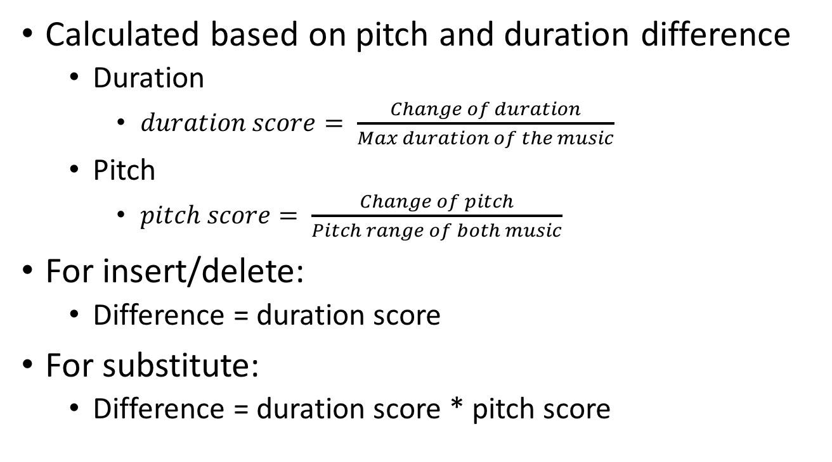
Cost function for comparison
Calculated based on pitch and duration difference
Duration
$duration score= \frac{Change of duration}{Max duration of the music}$
Pitch
$pitch score= \frac{Change of pitch}{Pitch range of both music}$
For insert/delete:
Difference = duration score
For substitute:
Difference = duration score * pitch score

Slide 27
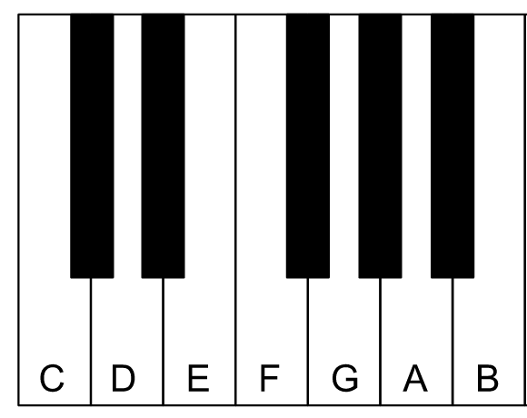
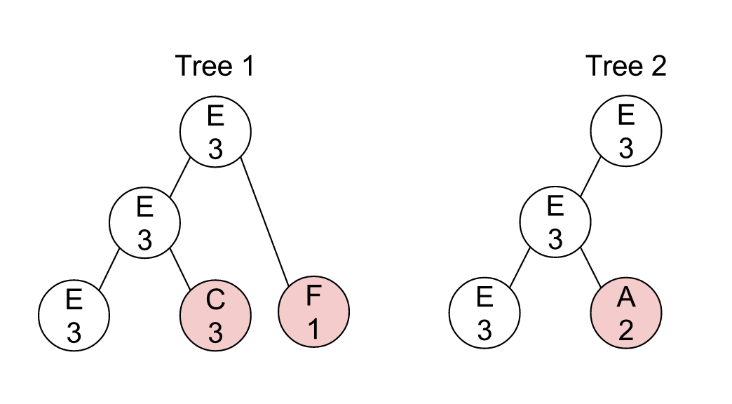
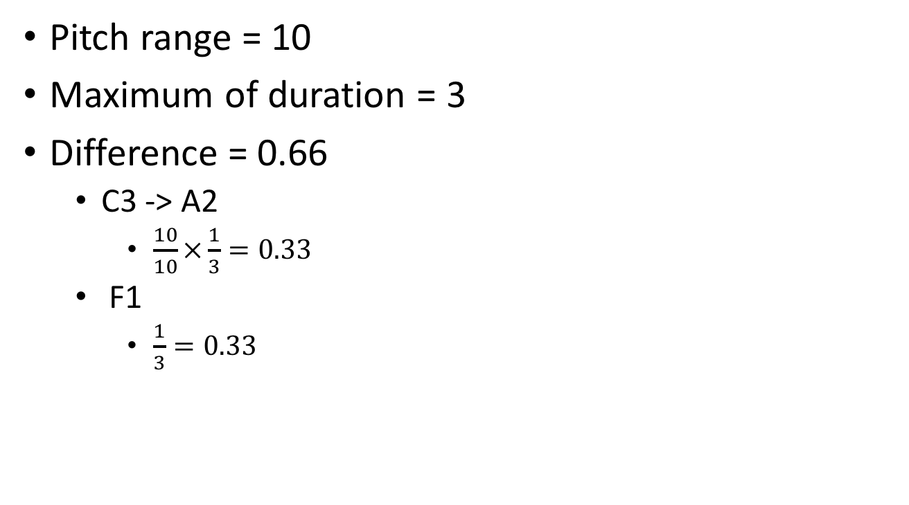
Example of difference calculation
Pitch range = 10
Maximum of duration = 3
Difference = 0.66
C3 -> A2
$\frac{10}{10}×\frac{1}{3}=0.33$
F1
$\frac{1}{3}=0.33$

Slide 28
Tree height threshold
Nodes with height within threshold will be considered in calculating tree editing distance.

Slide 29
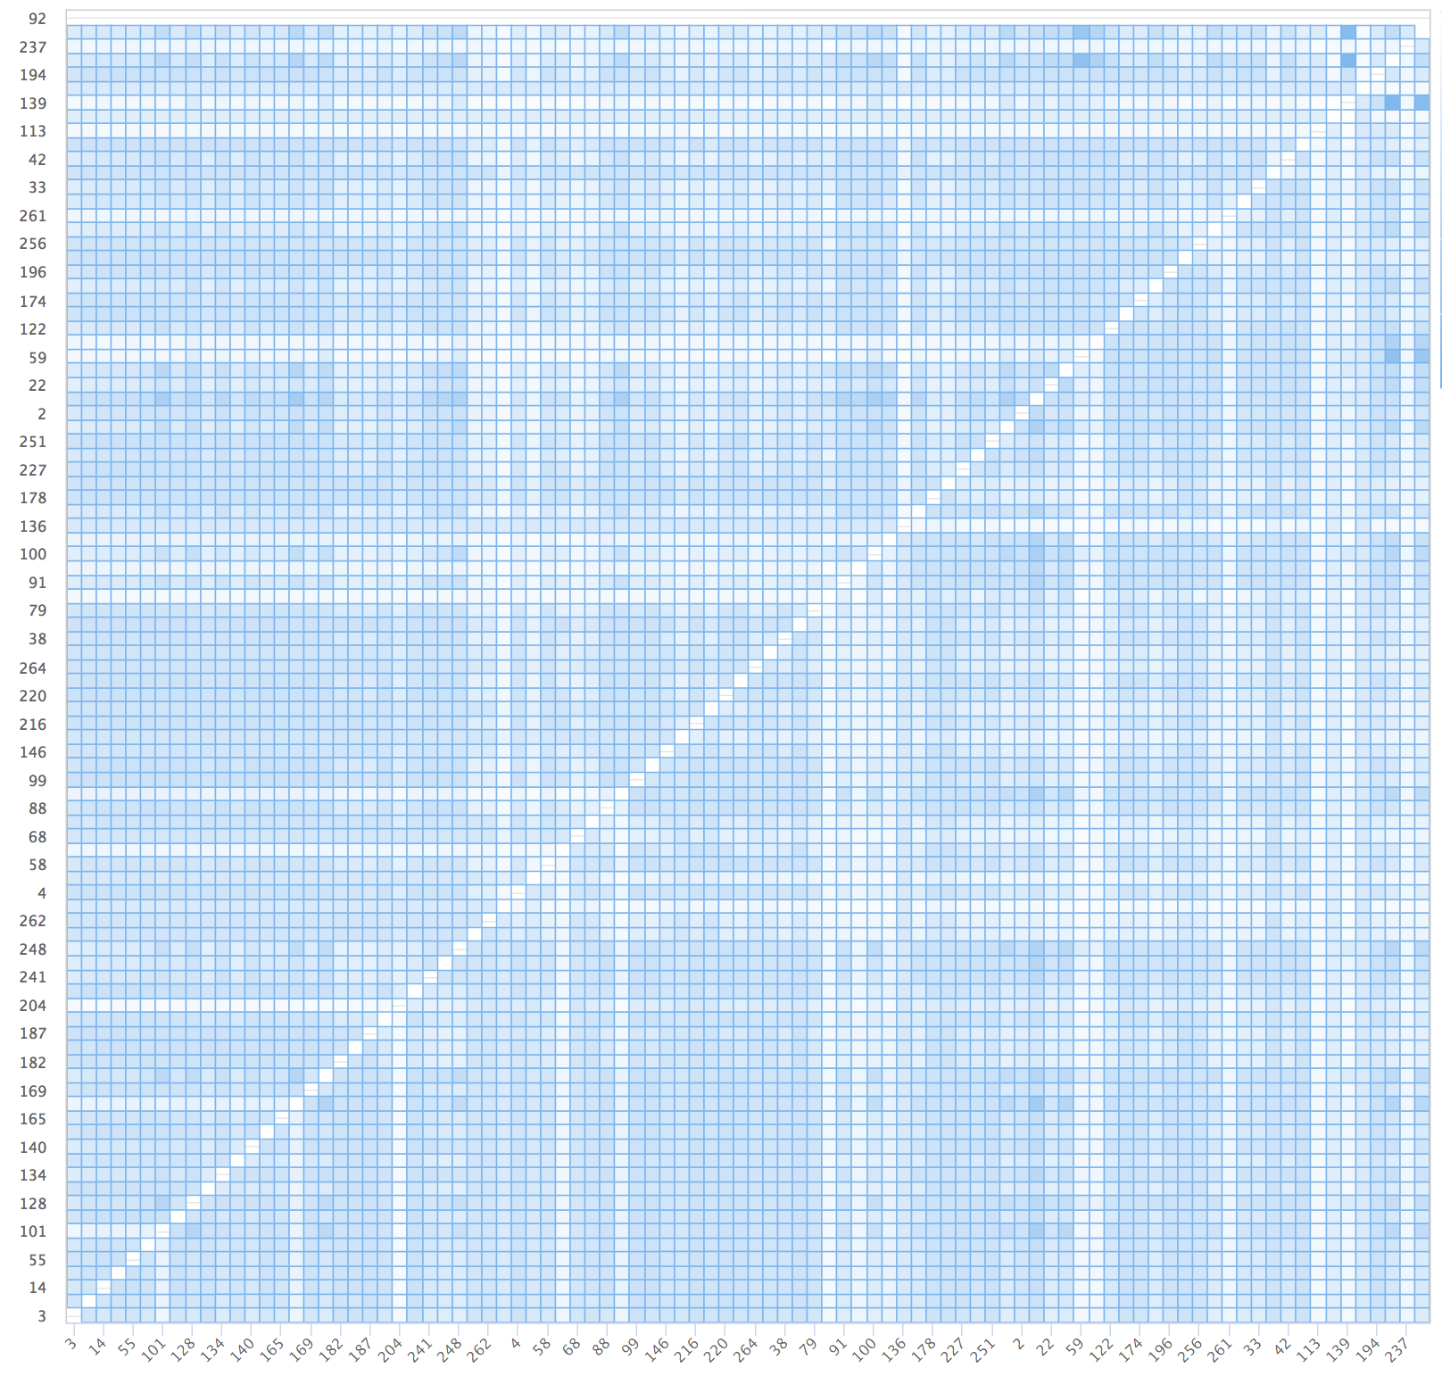
Result of tree comparison
Distance matrix

Slide 30
Music similarity visualization

Slide 31
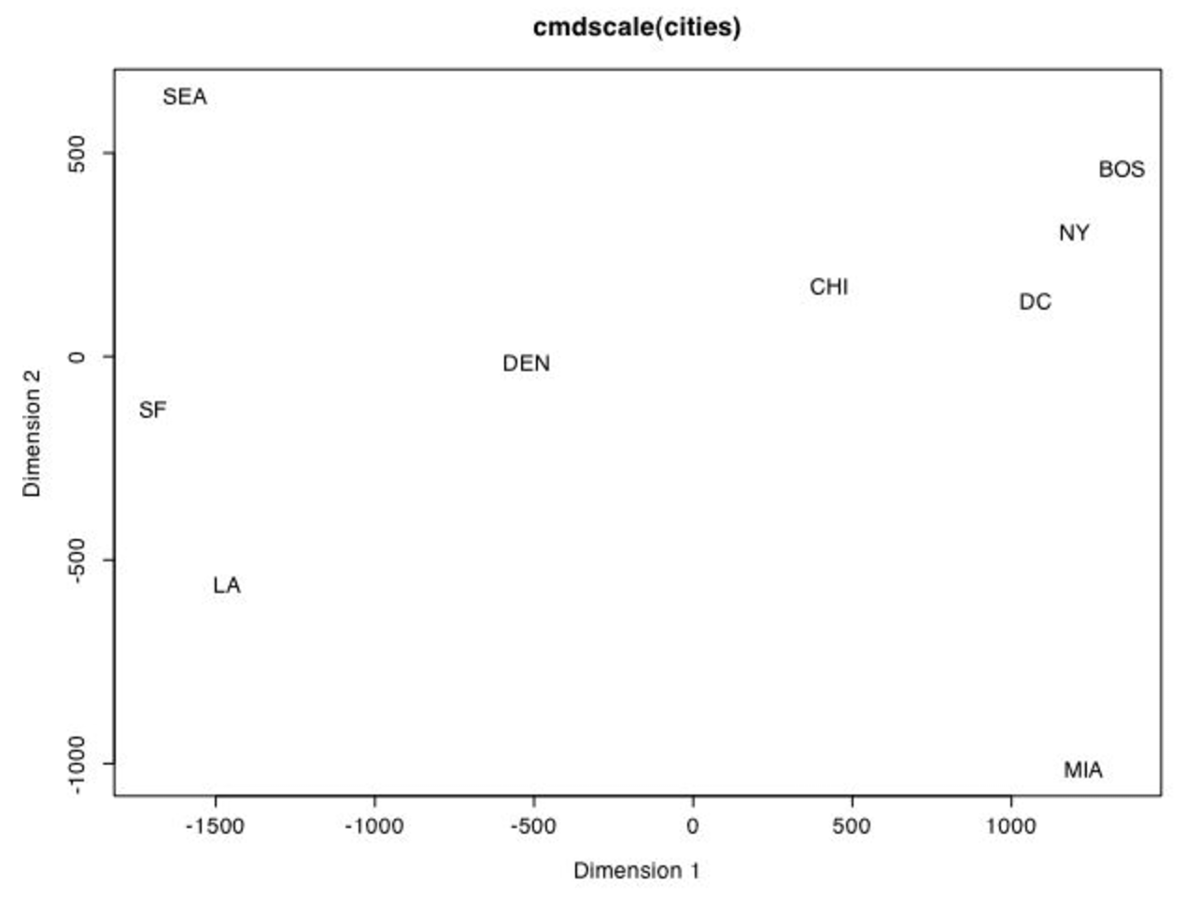
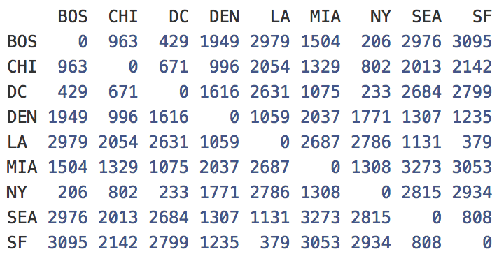
Visualization for similarity
Multidimensional scaling (MDS)
Transform distance matrix into points with position

Slide 32
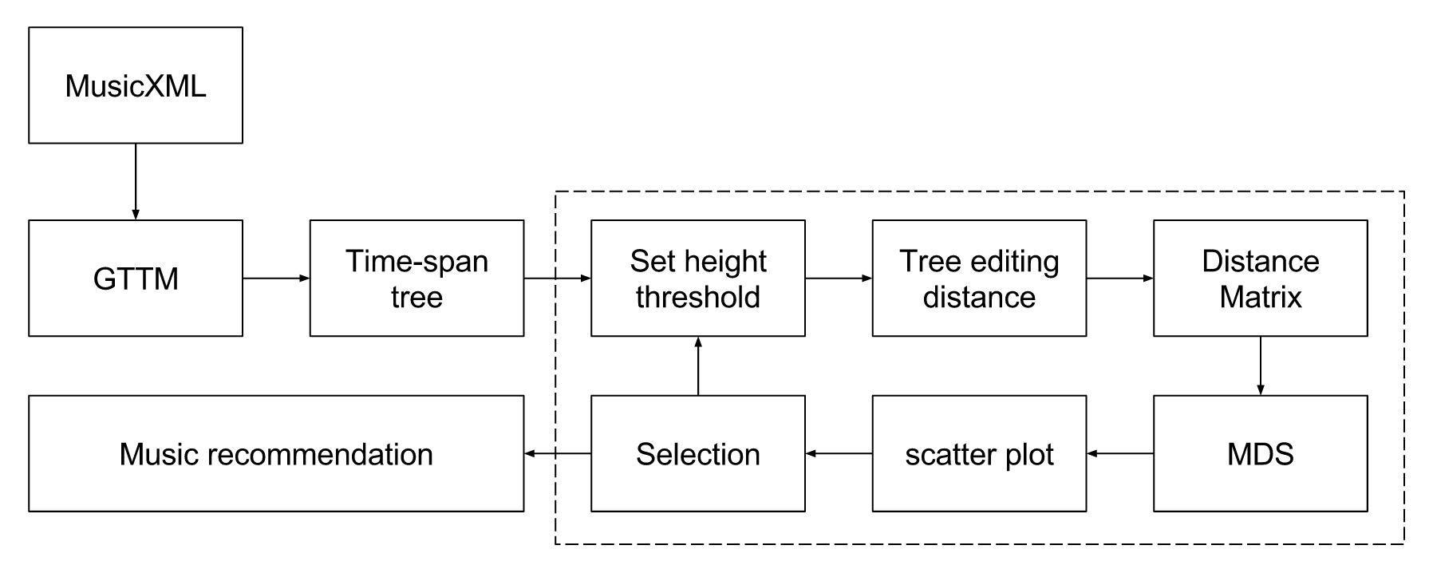
Pipeline for recommendation

Slide 33
Example case
”Recommendation from Schubert’s Ellens Gesang”
Start with unset threshold
Horseshoe effect
Only local distance are known

Slide 34
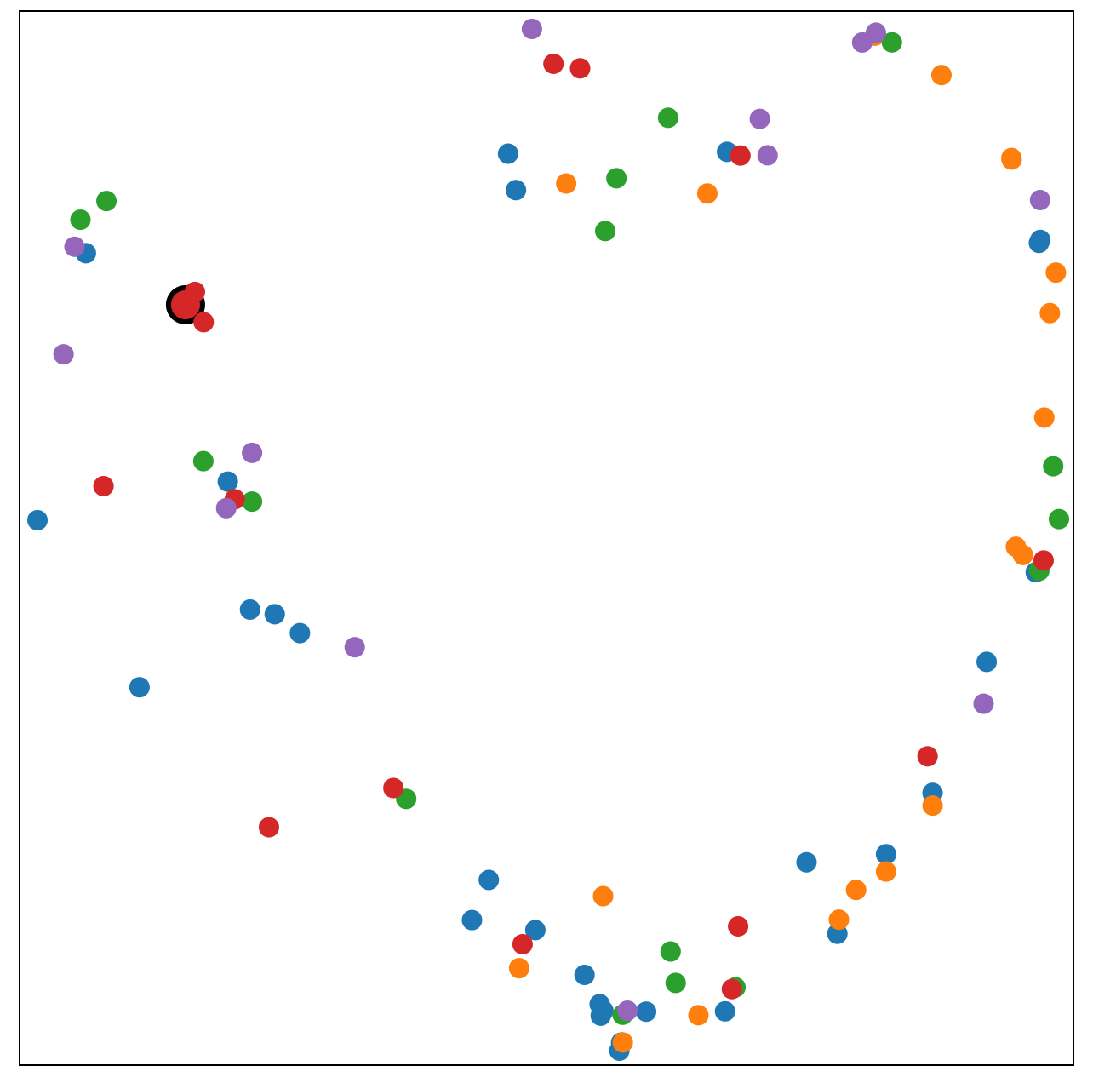
Example case – threshold unset

Slide 35
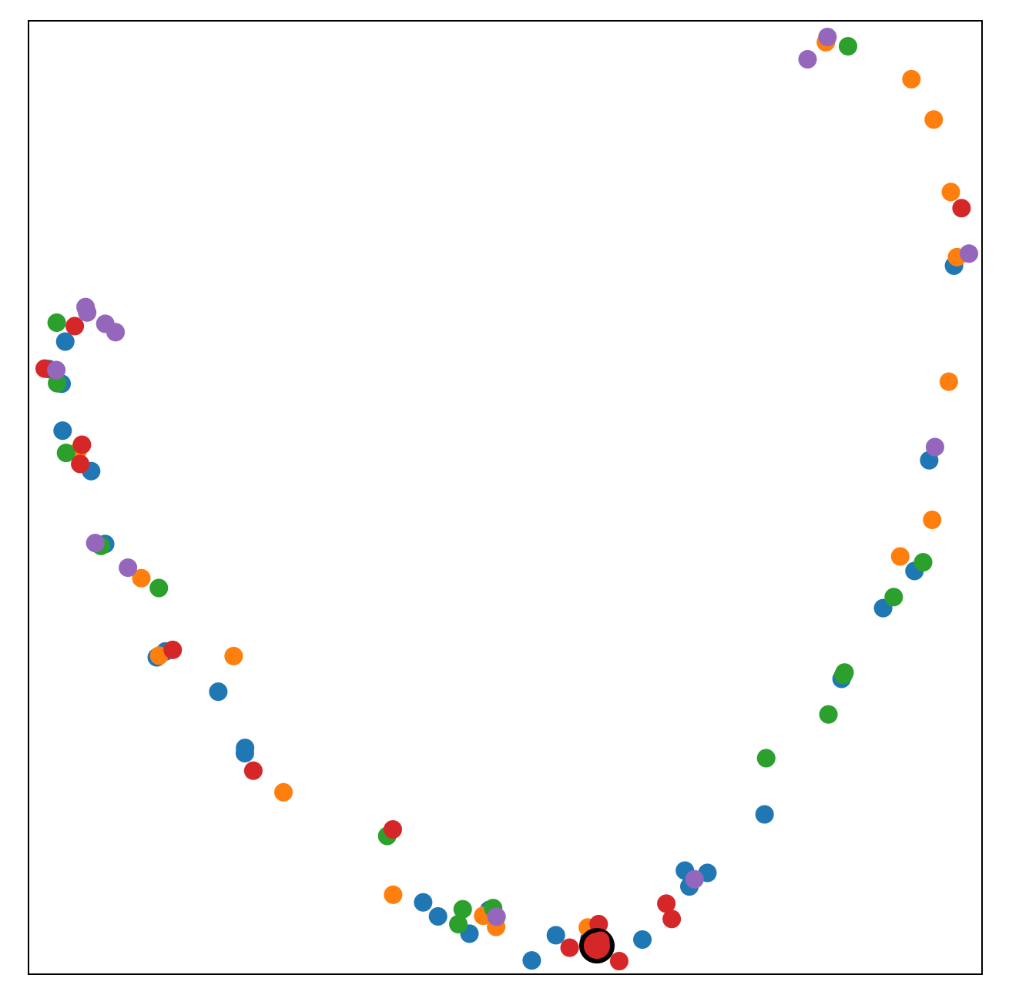
Example case – threshold at 5

Slide 36
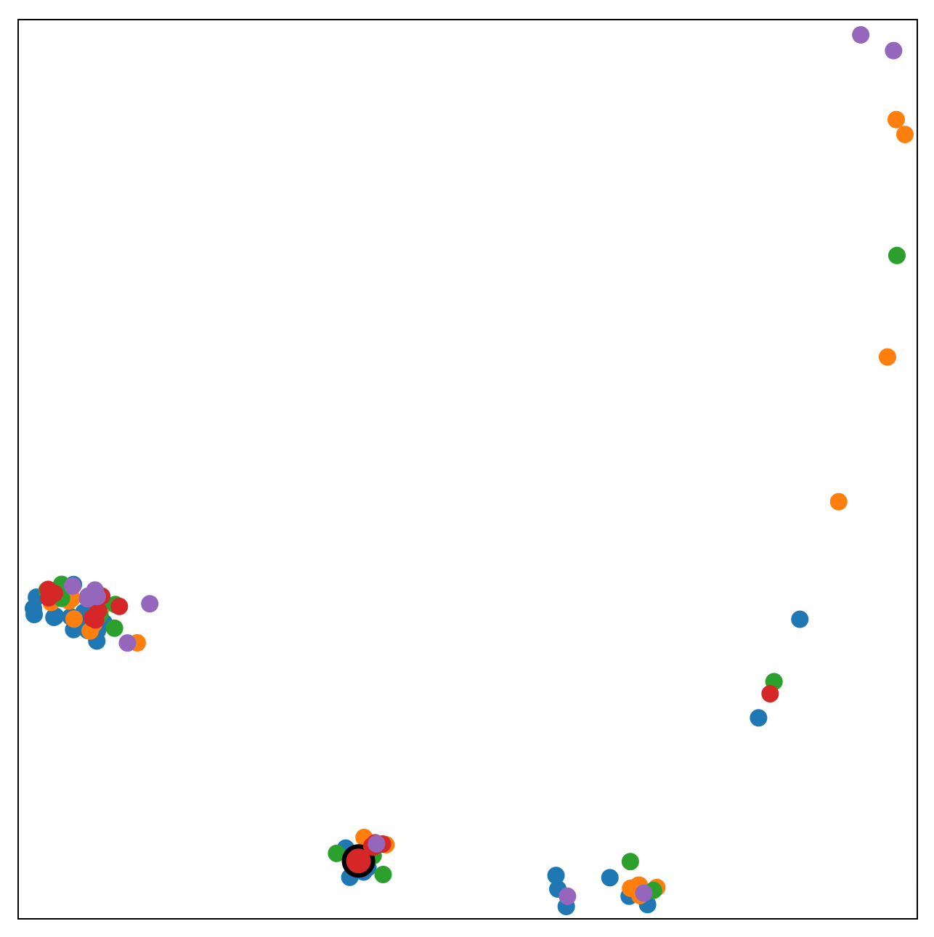
Example case – threshold at 4

Slide 37
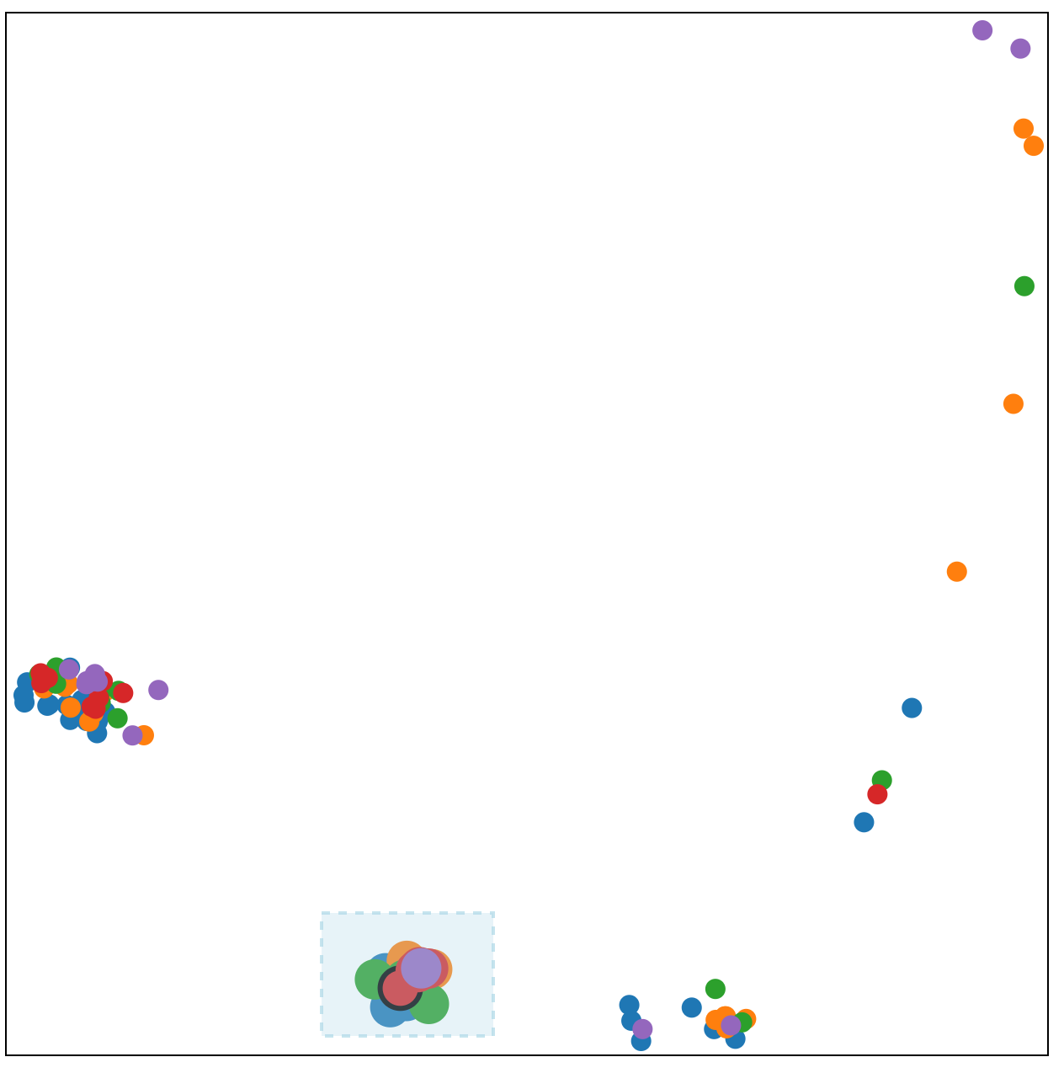
Example case – select cluster

Slide 38
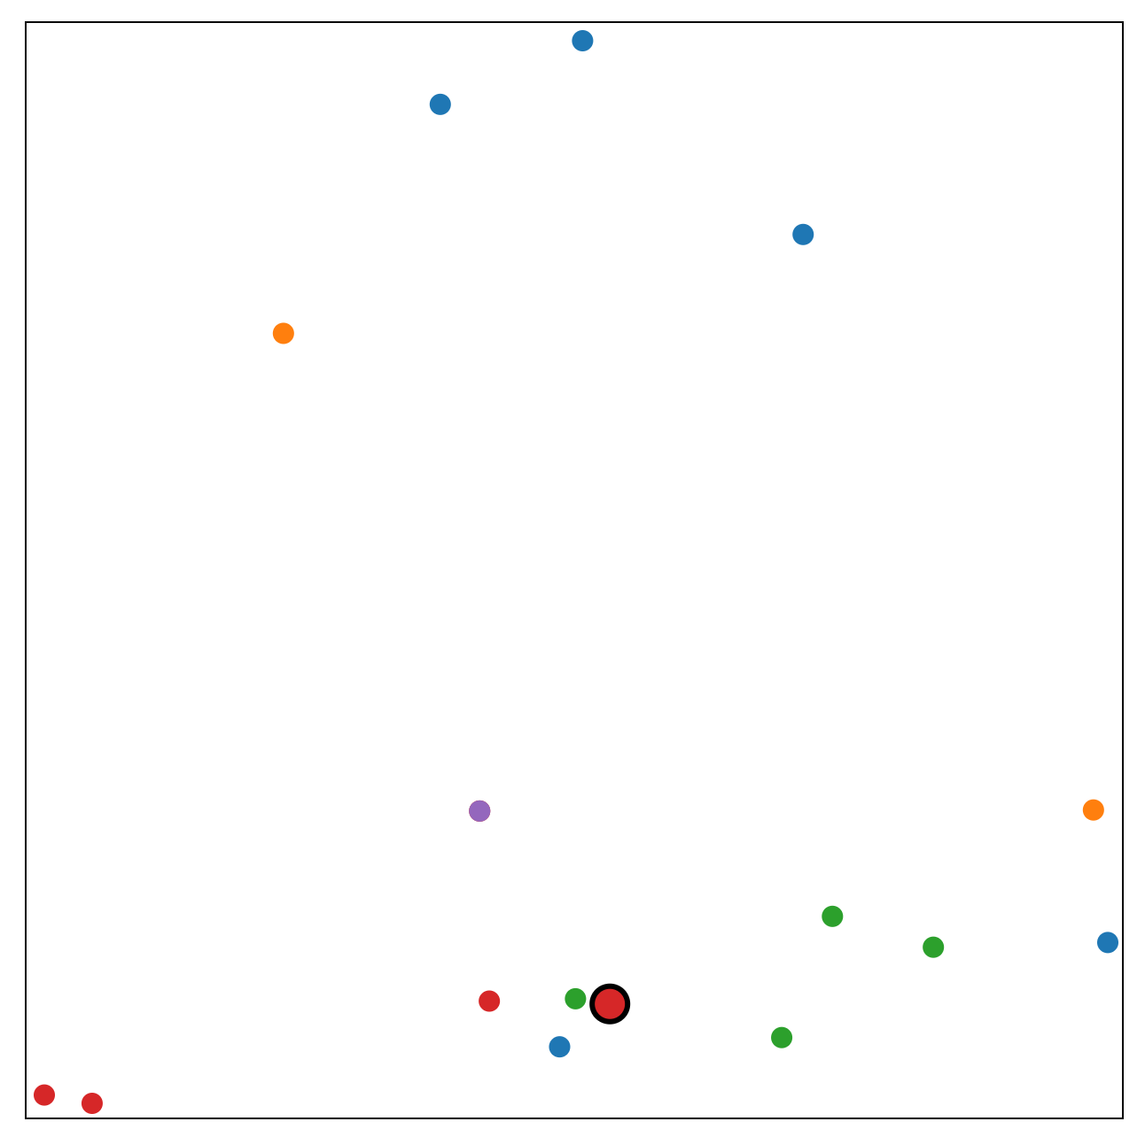
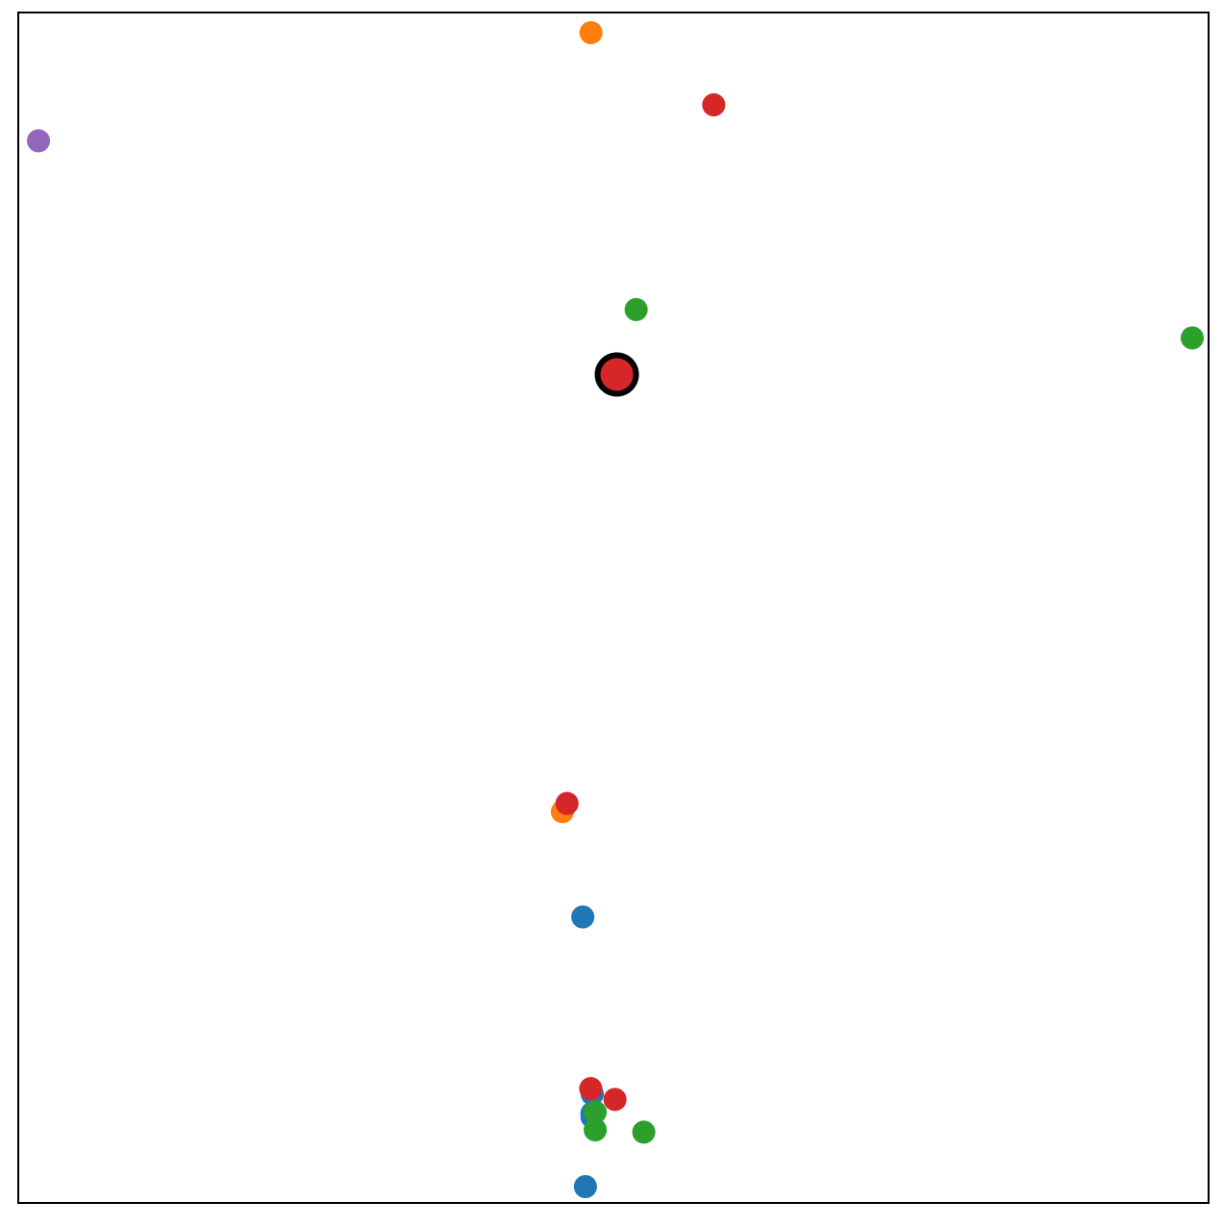
Example case – selection re-plot
Threshold 4
Threshold unset

Slide 39
Pattern discovery

Slide 40
Visualization of time-span tree
Find patterns and define repeating phrases
Combining tree visualization and piano roll
Similarity based on the string describing the entire subtree
Algorithm 1 Create string for every nodes in a tree
1: | procedure treeString(A)
2: | if no children in A do
3: | A.string = A.duration
4: | else do
5: | A.string = “<” + treeString(A.left) + “|” + treeString(A.right) + “>”
6: | return A.string
7: | end procedure

Slide 41
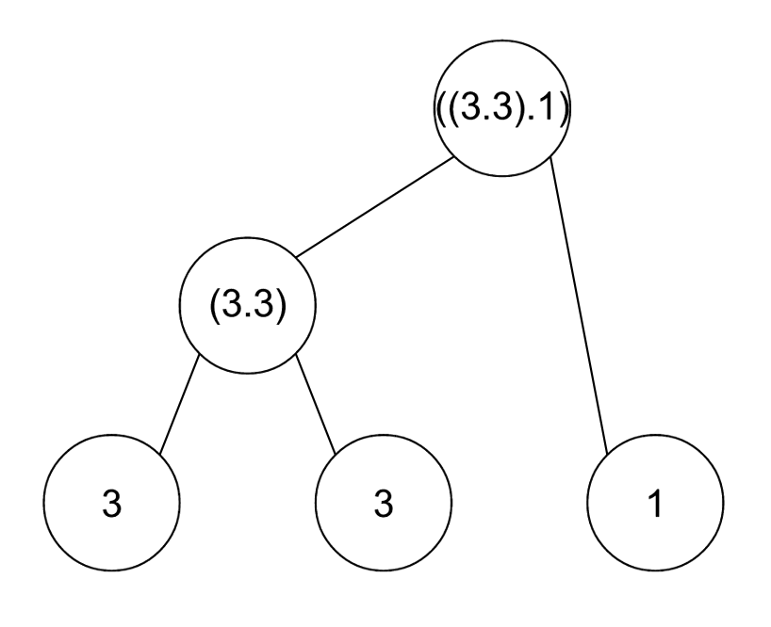
Visualization of time-span tree
Example of sub-tree string

Slide 42
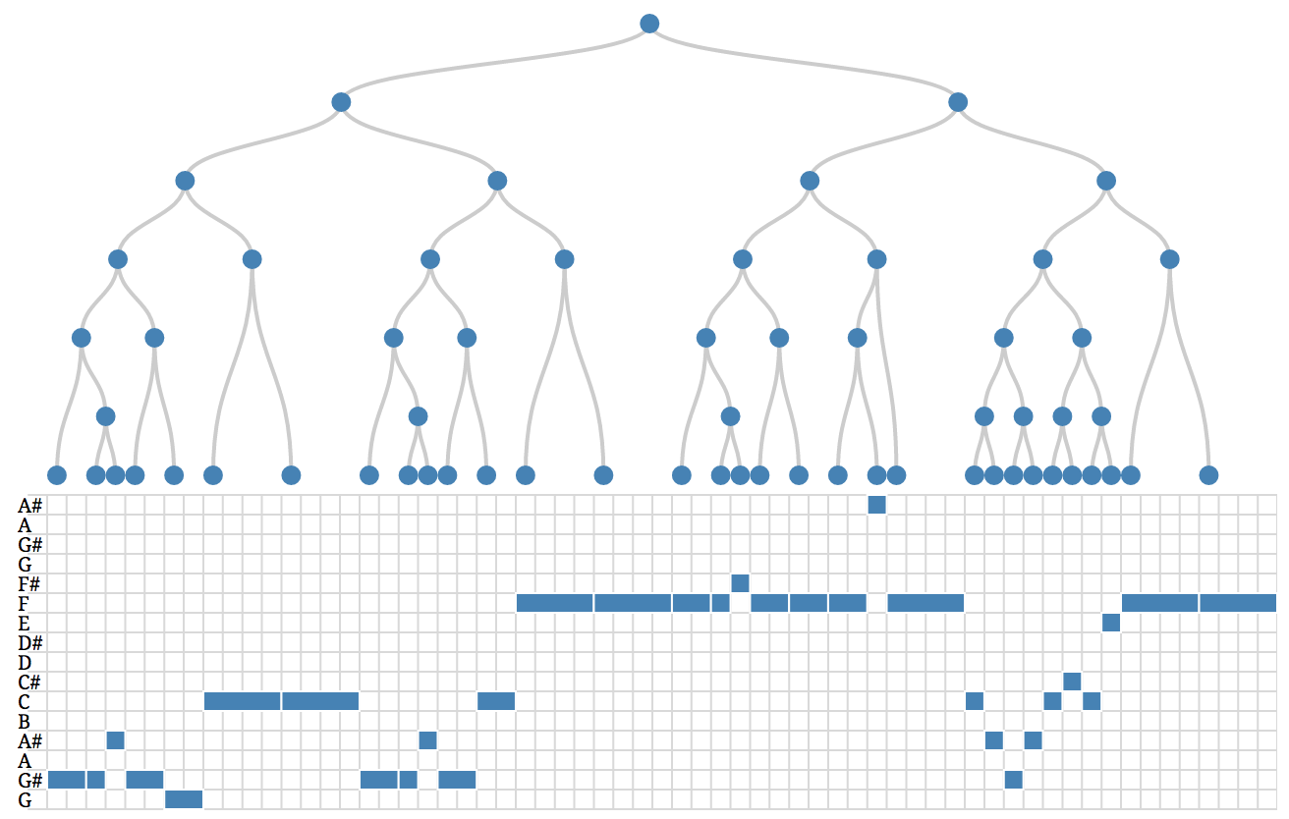
Example case – pattern discovery

Slide 43
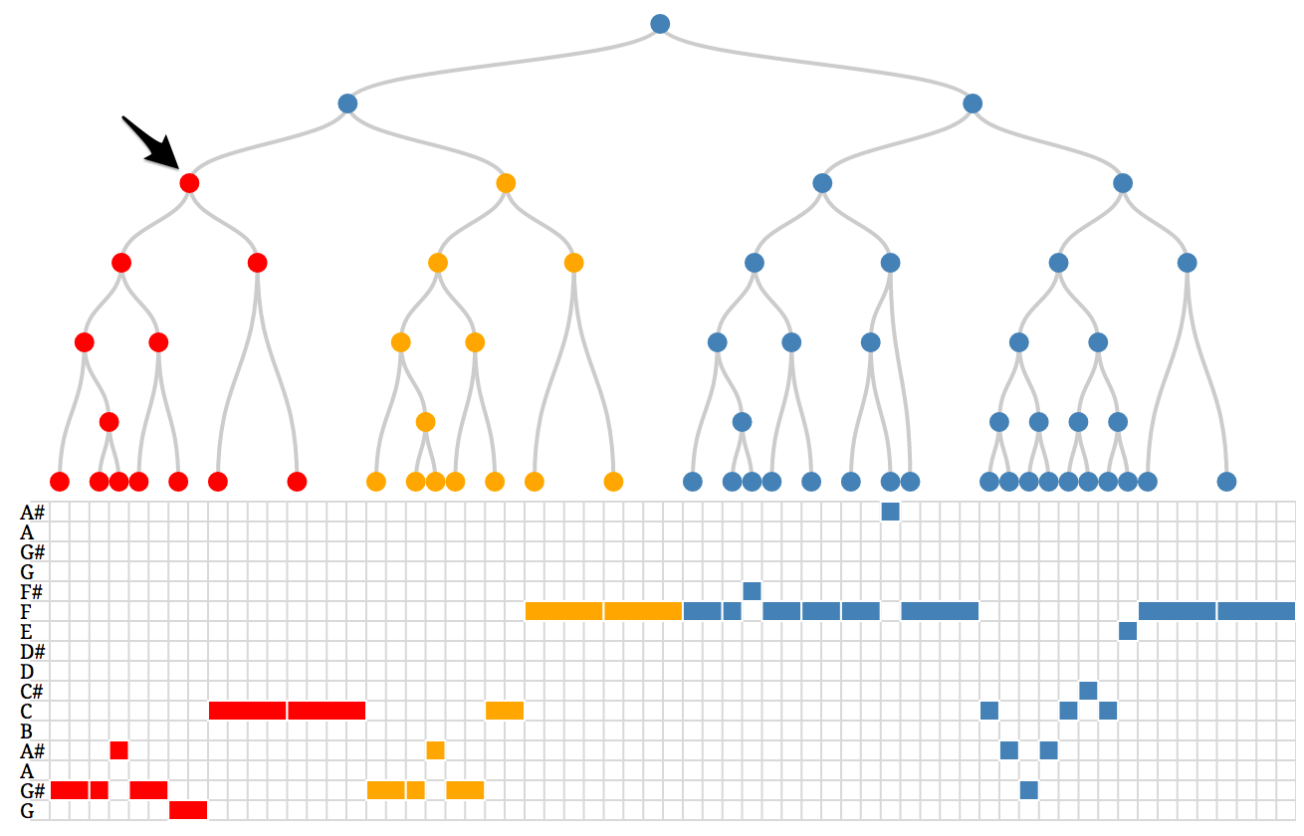
Example case – pattern discovery

Slide 44
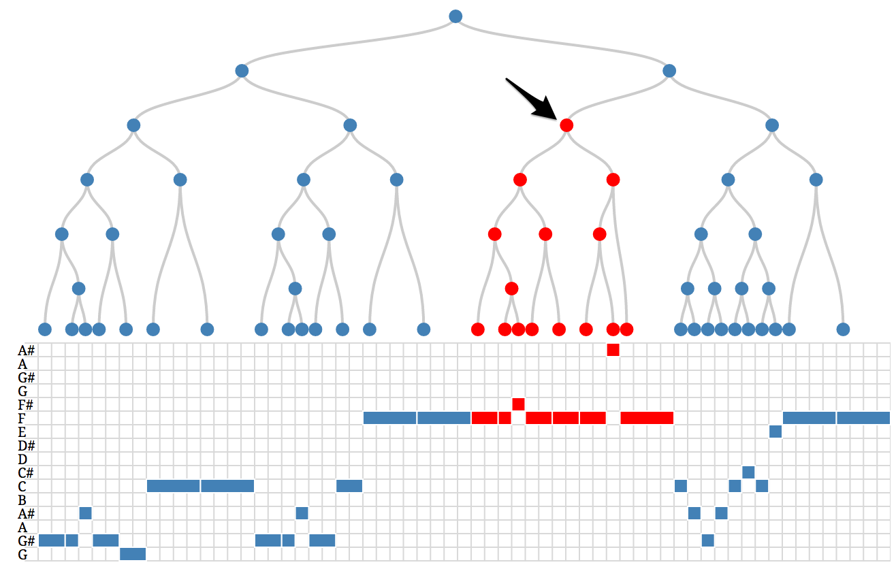
Example case – pattern discovery

Slide 45
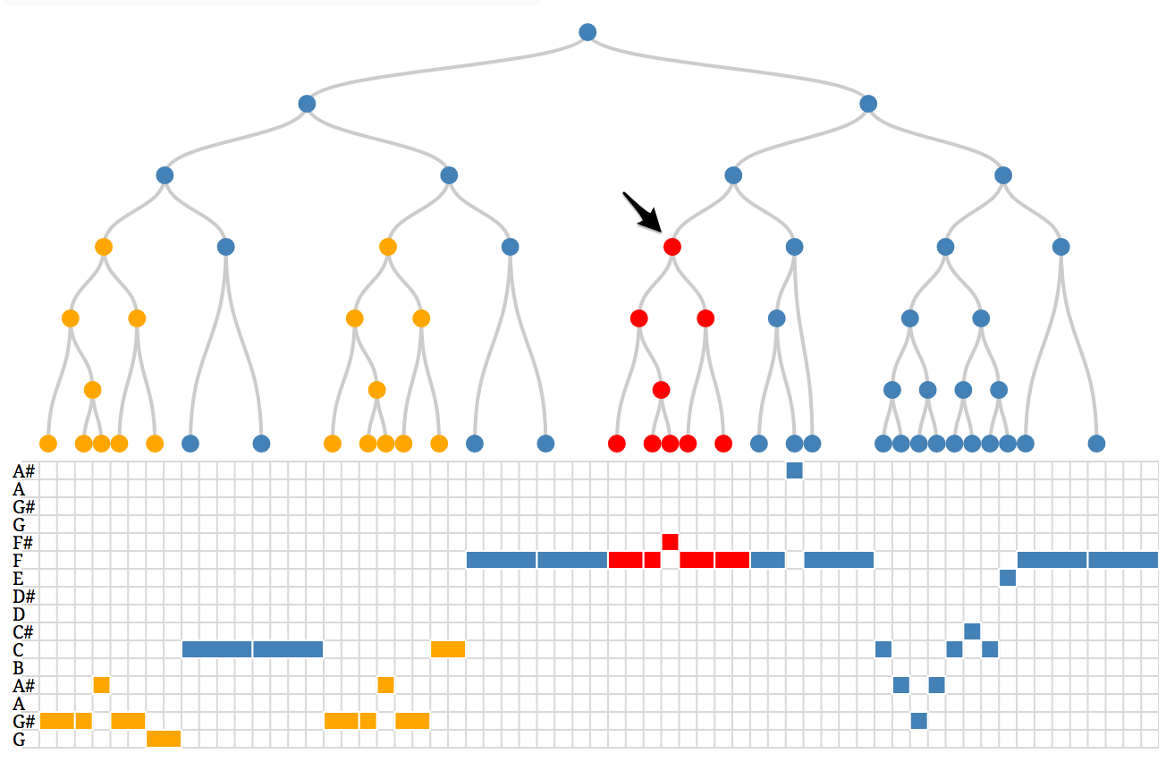
Example case – pattern discovery

Slide 46
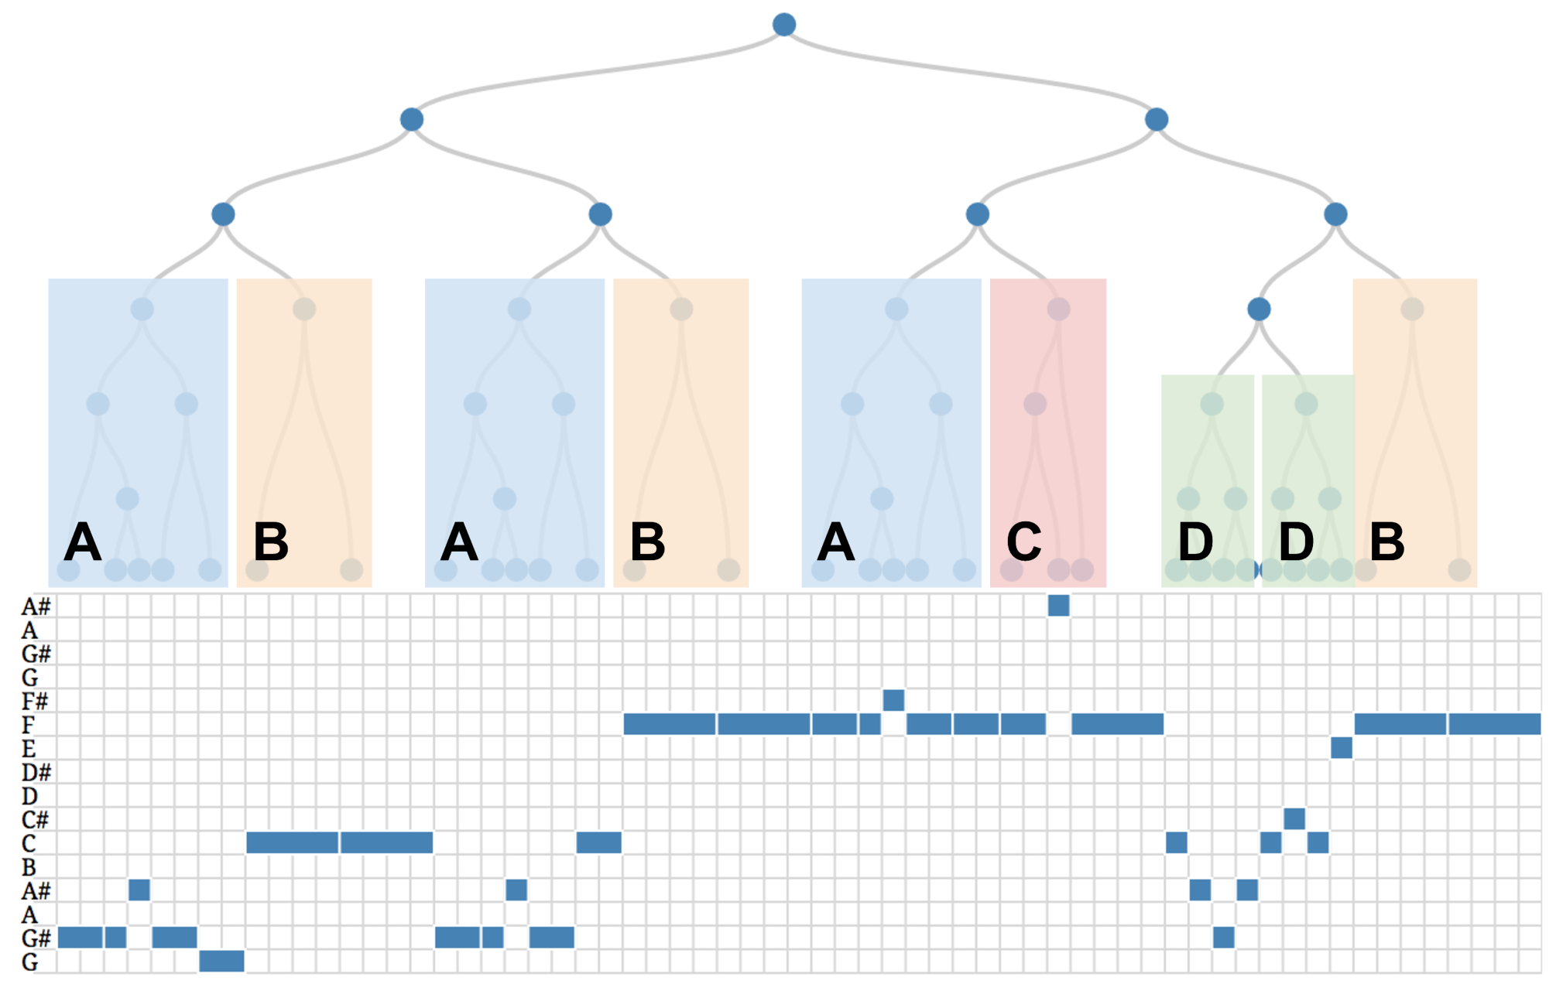
Example case – pattern discovery

Slide 47
Recap
Based on music theory, A Generative Theory of Tonal Music (GTTM), this project allow user to find similar music based on different level of abstraction.
Also allow user to discover patterns of a music.

Slide 48
Questions?

